Slide 1
SLiPaD
Smart Lighting with Parking Detection
Implementation
Embedded Systems
Group 9: Diogo Fernandes – A88262
José Tomás Abreu – A88218

Slide 2
Agenda
Problem Statement Review
Hardware Implementation
Expenses comparison
Test cases
Software Implementation
Test cases
Project constraints
Conclusion
Competencies learnt
Difficulties encountered
Solution fits the problem?
Future Work
Improvements

Slide 3
Problem Statement Review

Slide 4
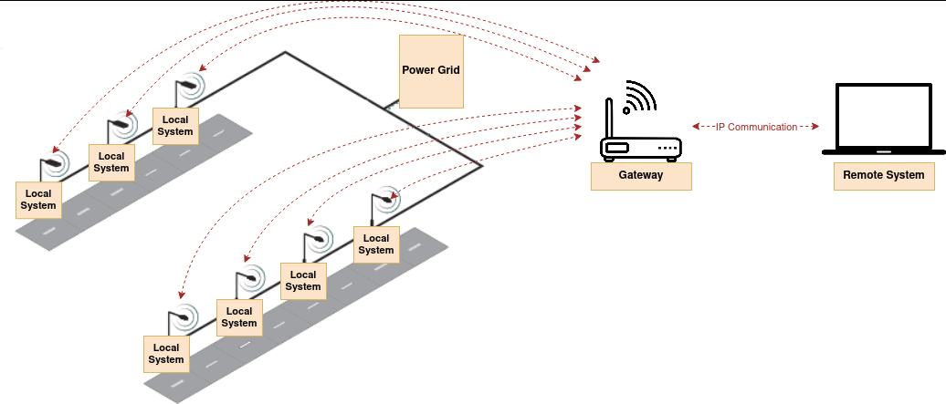
Network Architecture

Slide 5
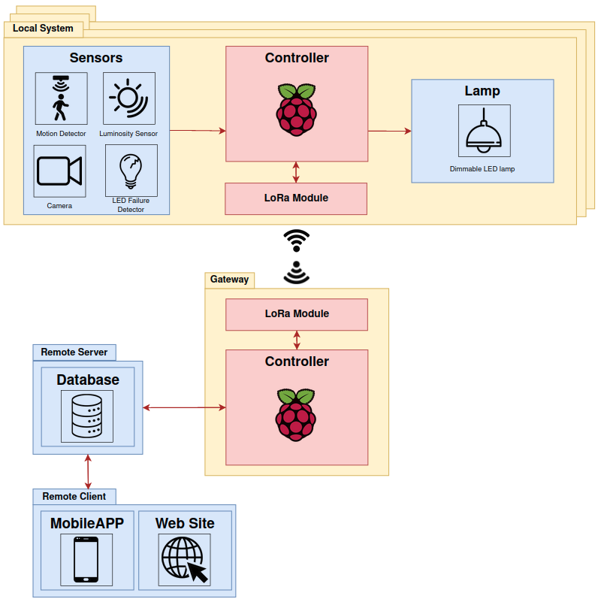
Local system Overview

Slide 6
Hardware Implementation

Slide 7
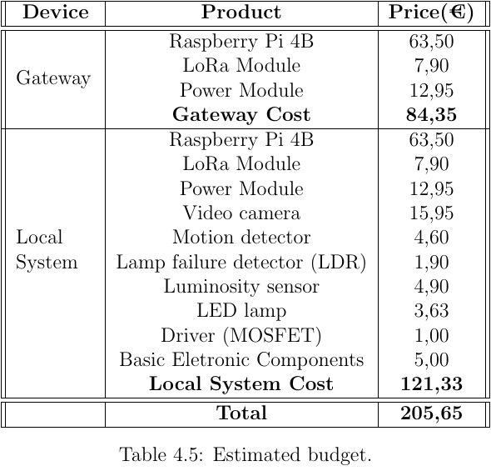
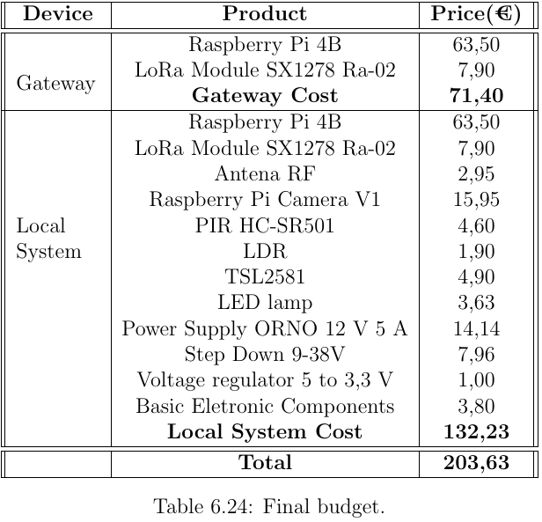
Expenses Comparison

Slide 8
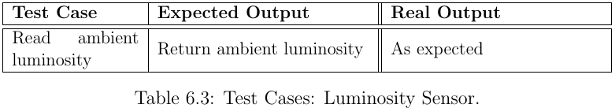
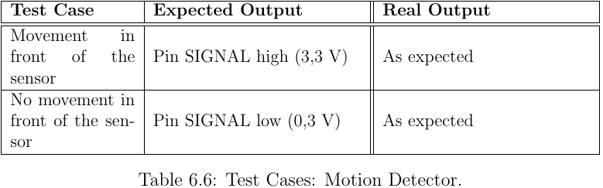
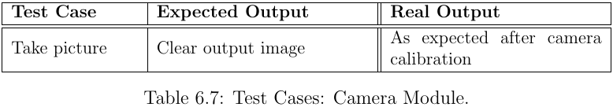
Test Cases

Slide 9
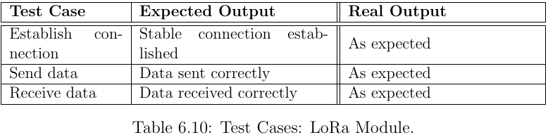
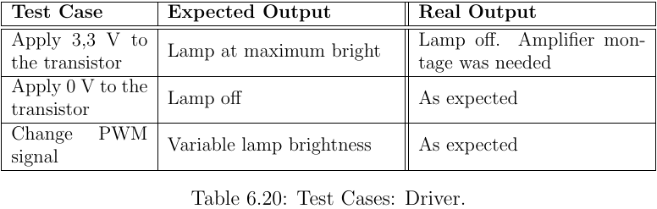
Test Cases

Slide 10
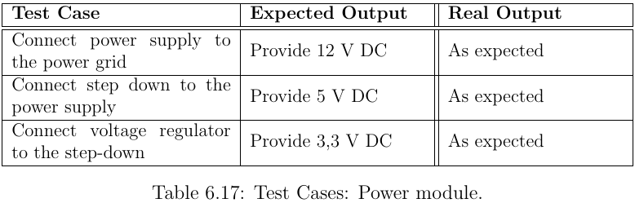
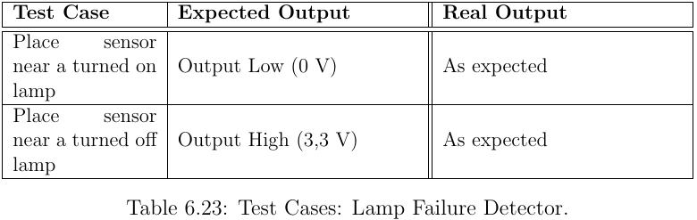
Test Cases

Slide 11
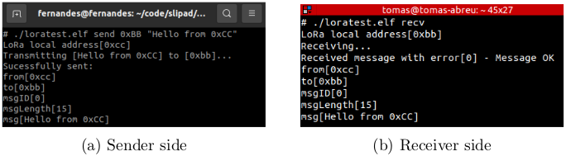
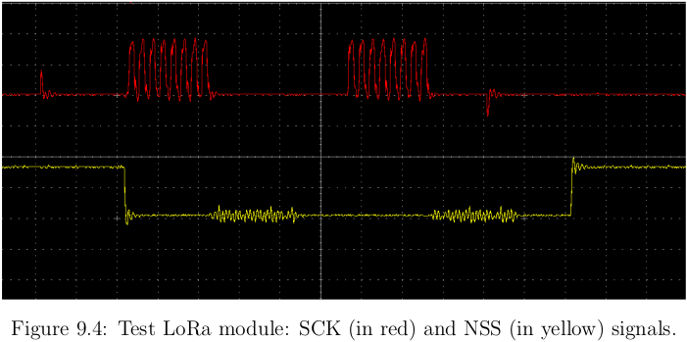
LoRa Test Cases

Slide 12
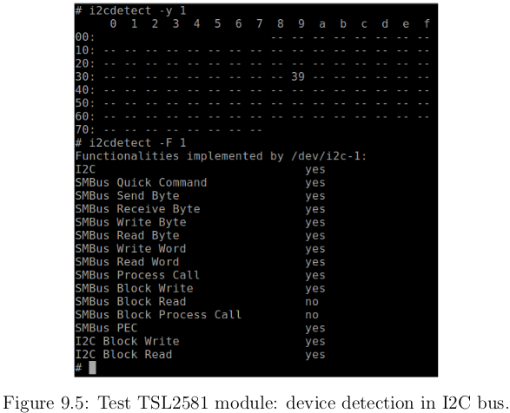
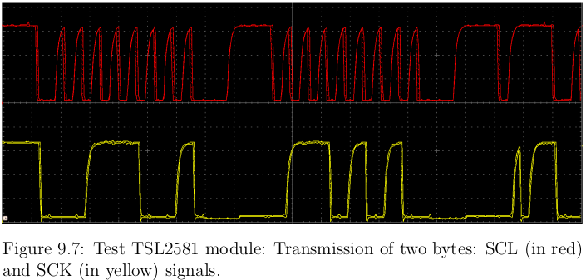
Luminosity Sensor
Test Cases

Slide 13
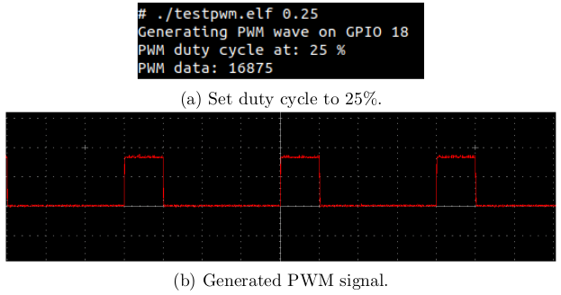
PWM Test Cases

Slide 14
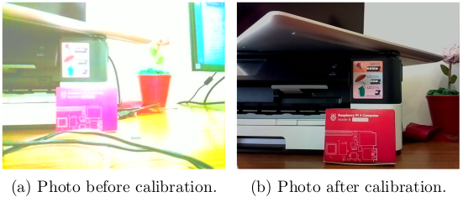
Camera Test Cases

Slide 15
Software Implementation

Slide 16
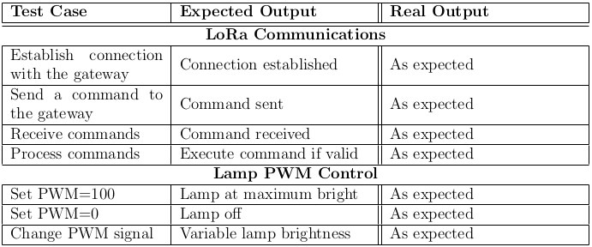
Local System
Test Cases

Slide 17
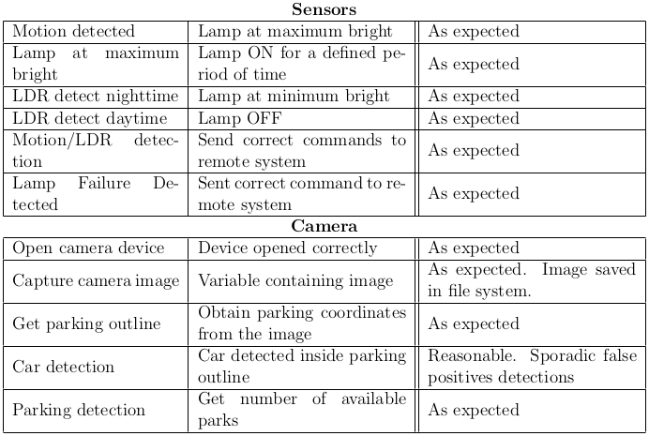
Local System
Test Cases

Slide 18
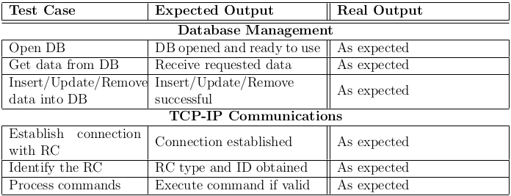
Remote System
Test Cases

Slide 19
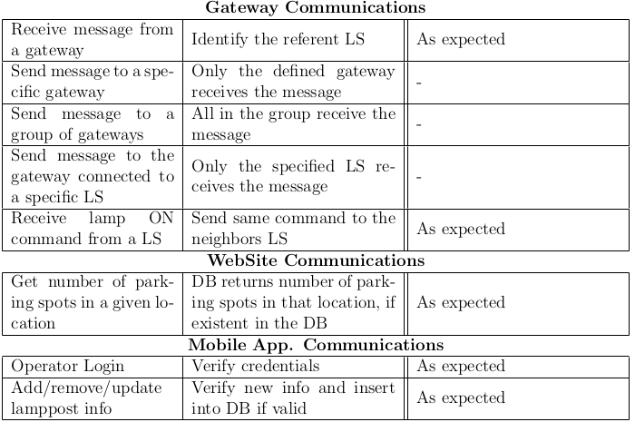
Remote System
Test Cases

Slide 20
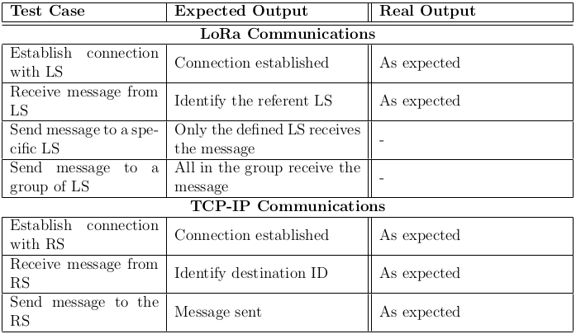
Gateway
Test Cases

Slide 21
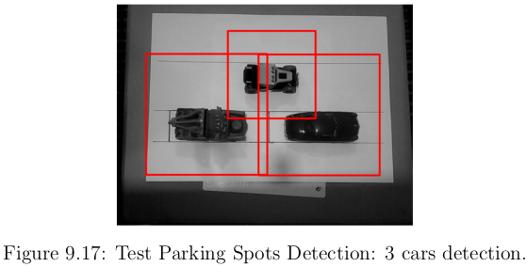
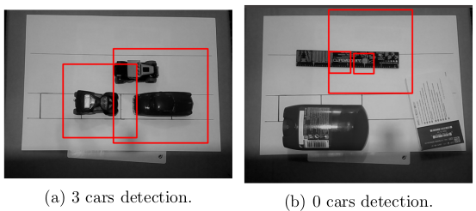
Car Detection
Test Cases

Slide 22
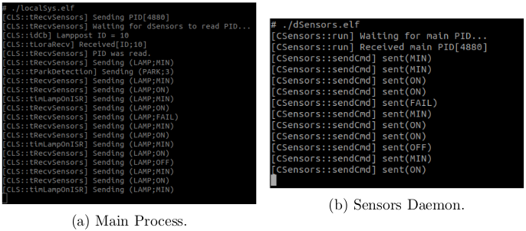
Local System
Test Cases

Slide 23
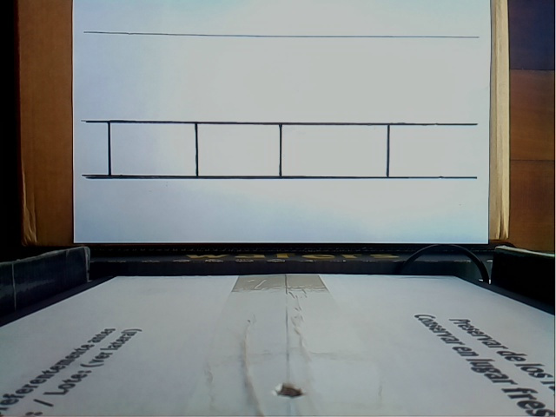
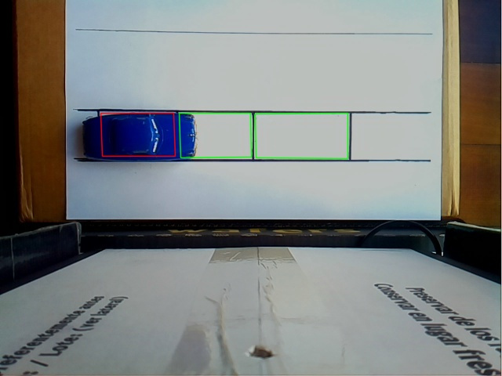
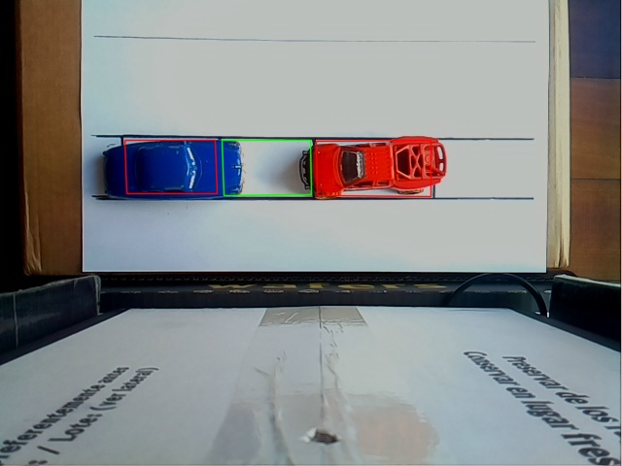
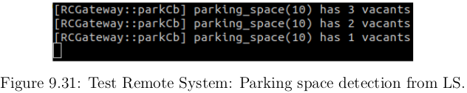
Parking Detection
Test Cases

Slide 24
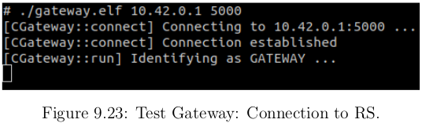
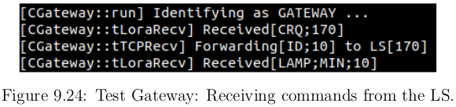
Gateway
Test Cases

Slide 25
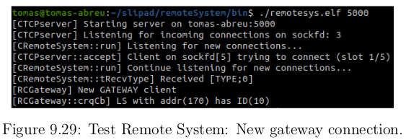
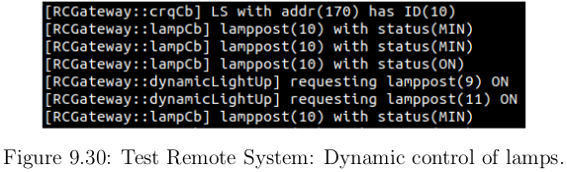
Remote System
Test Cases

Slide 26
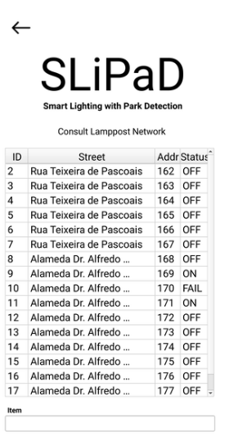
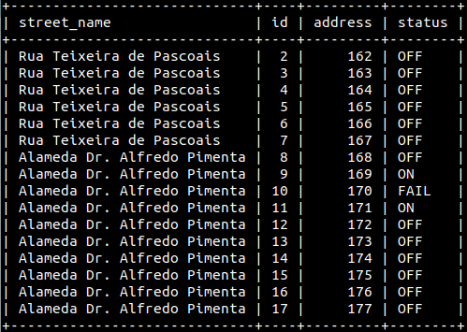
Remote Client
Test Cases

Slide 27
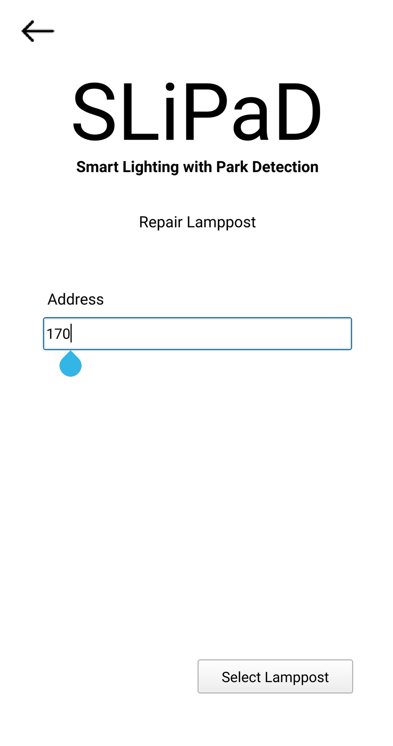
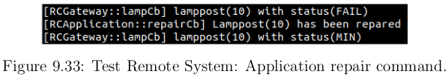
Remote Client
Test Cases

Slide 28
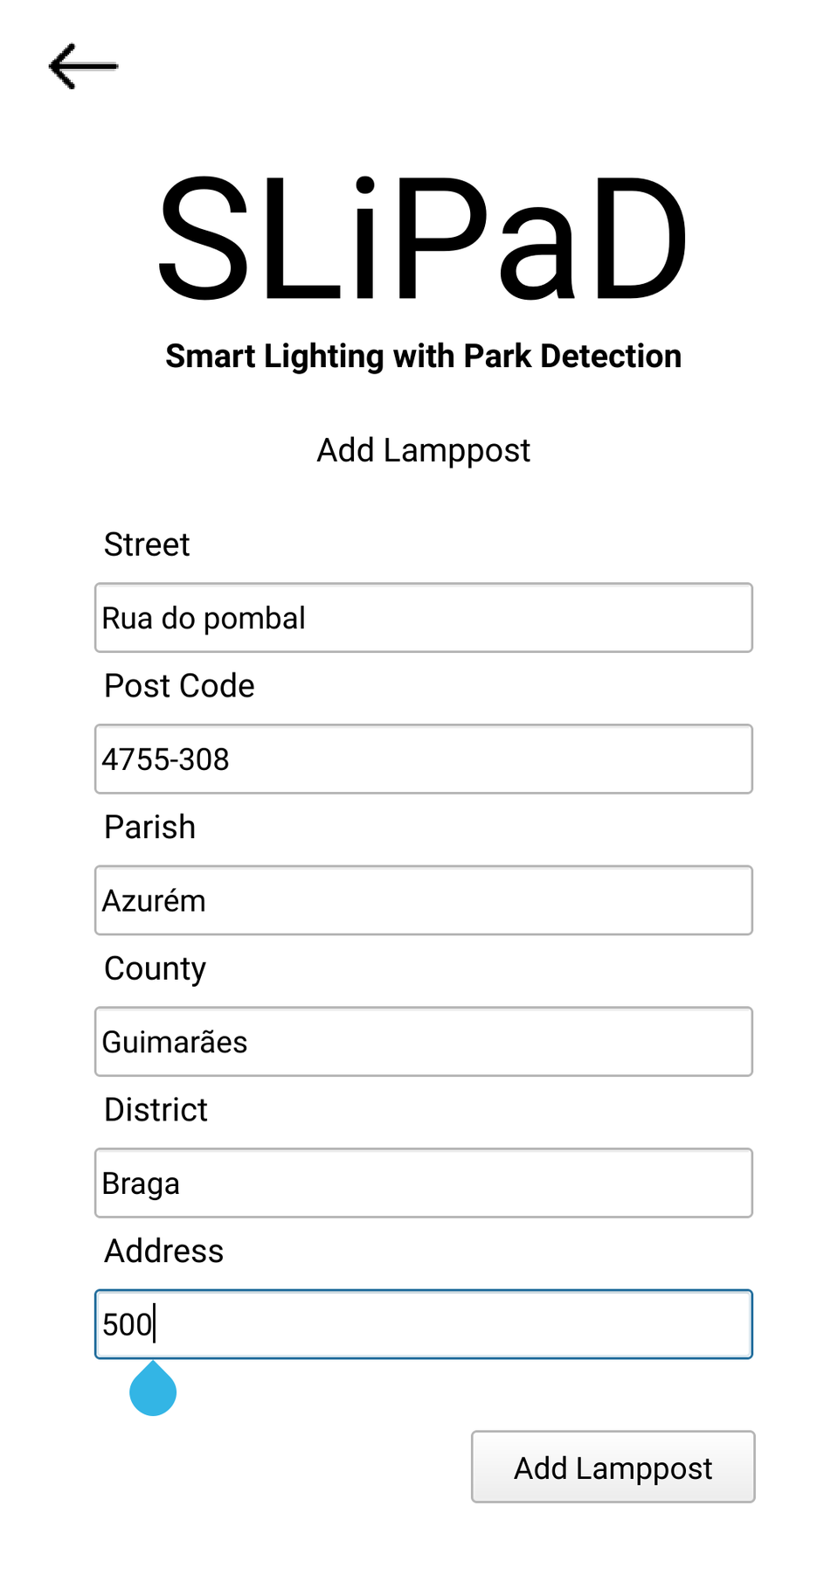
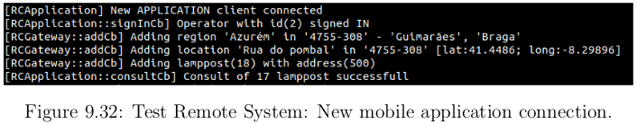
Remote Client
Test Cases

Slide 29
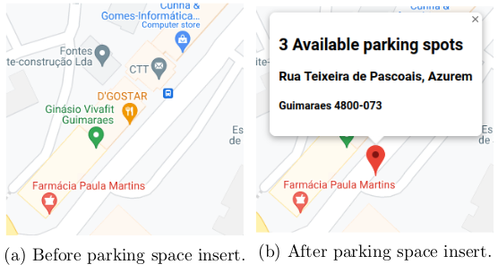
Remote Client
Test Cases

Slide 30
Project Constraints
Buildroot
Linux custom image
Linux
C, C++
Device Drivers
Motion detector
Lamp Failure detector
Raspberry Pi
Cyber-Physical System (CPS)
Using sensors and actuators
Makefiles
Pthreads
Multitasking

Slide 31
Competencies learnt
Git, GitHub
https://github.com/ESRGgroup9/slipad
Doxygen
https://esrggroup9.github.io/slipad/index.html
IPC Mechanisms
Mutexes, Condition Variables, Signals, Message Queues
Trello
Qt Creator
HTML, PHP, JavaScript
MySQL
Makefiles, CMakeList
OpenCV API
Google Maps API

Slide 32
Difficulties encountered
Problem Statement
Defining the problem and the solution
Analysis Phase
Defining type of communication between LS and RS
Buildroot configurations
OpenCV
LoRa Communication
SPI protocol
QT for Android
Configuration
Present lamppost network in a map
Time constraint

Slide 33
Solution fits the problem?
Reduced energy costs in public lighting;
Reduced the search time for parking spots in a city;
Lamppost must be installed in an area nearby parking spaces;
Remote System should be online;

Slide 34
Future Work
Improve car detection classifier;
Improve system’s encapsulation;
Encryption in LoRa communication;
Change execution environment of RS to the cloud;
Improve dynamic control of lampposts;
Implementation of map to consult lamppost network;
Include parking spaces information in an application such as Google Maps;

Slide 35
Improvements
Improve analysis phase:
Use cases;
Sequence diagrams;
Deeper design phase;
Improve project planning:
Gantt Diagram;
Time management;
Tasks identification and distribution;

Slide 36
Questions?

